Slide 1
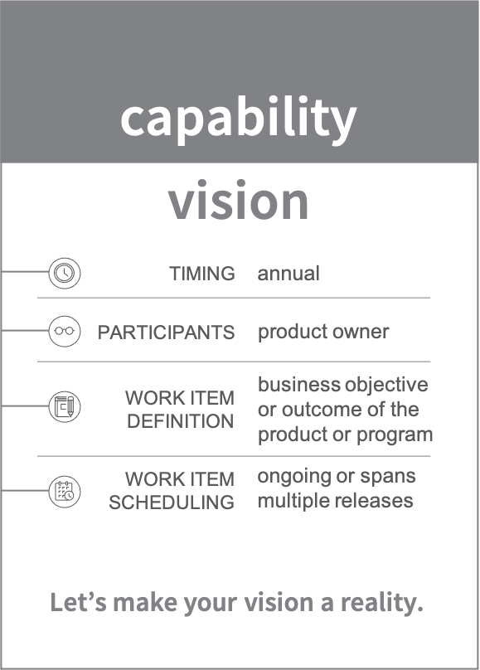
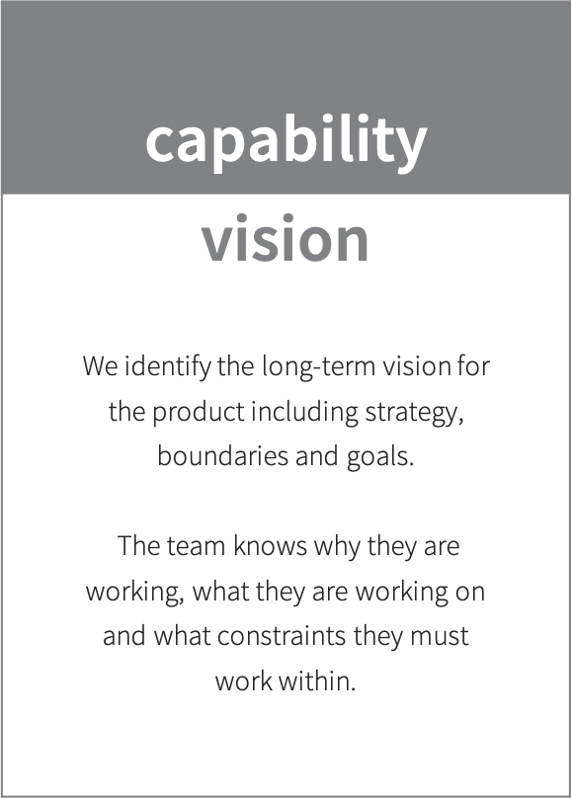
Vision
Vision is a quick summary of the product and defines its capabilities. Essentially, it answers the following questions:
Who are the target users?
Which customer needs does this address?
Which attributes are critical to satisfy the consumer’s needs, and therefore critical for the success?
What are the unique selling points?

Slide 2
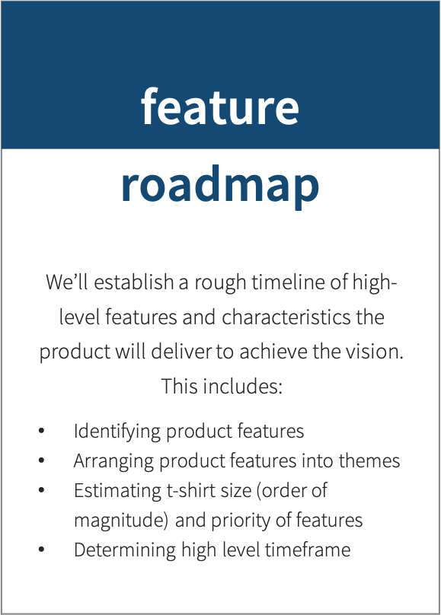
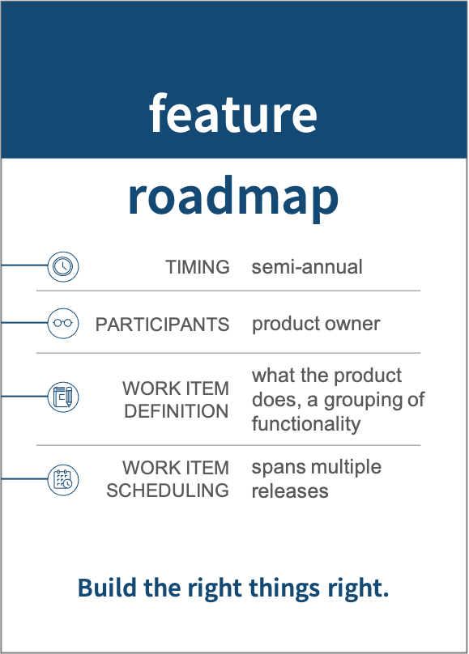
Roadmap
Roadmap refines the defined capabilities into features.
A rough timeline will be established to achieve the vision.
Stakeholders will elaborate features from the capabilities
A rough t-shirt size for each feature is determined
A high-level timeframe is outlined

Slide 3
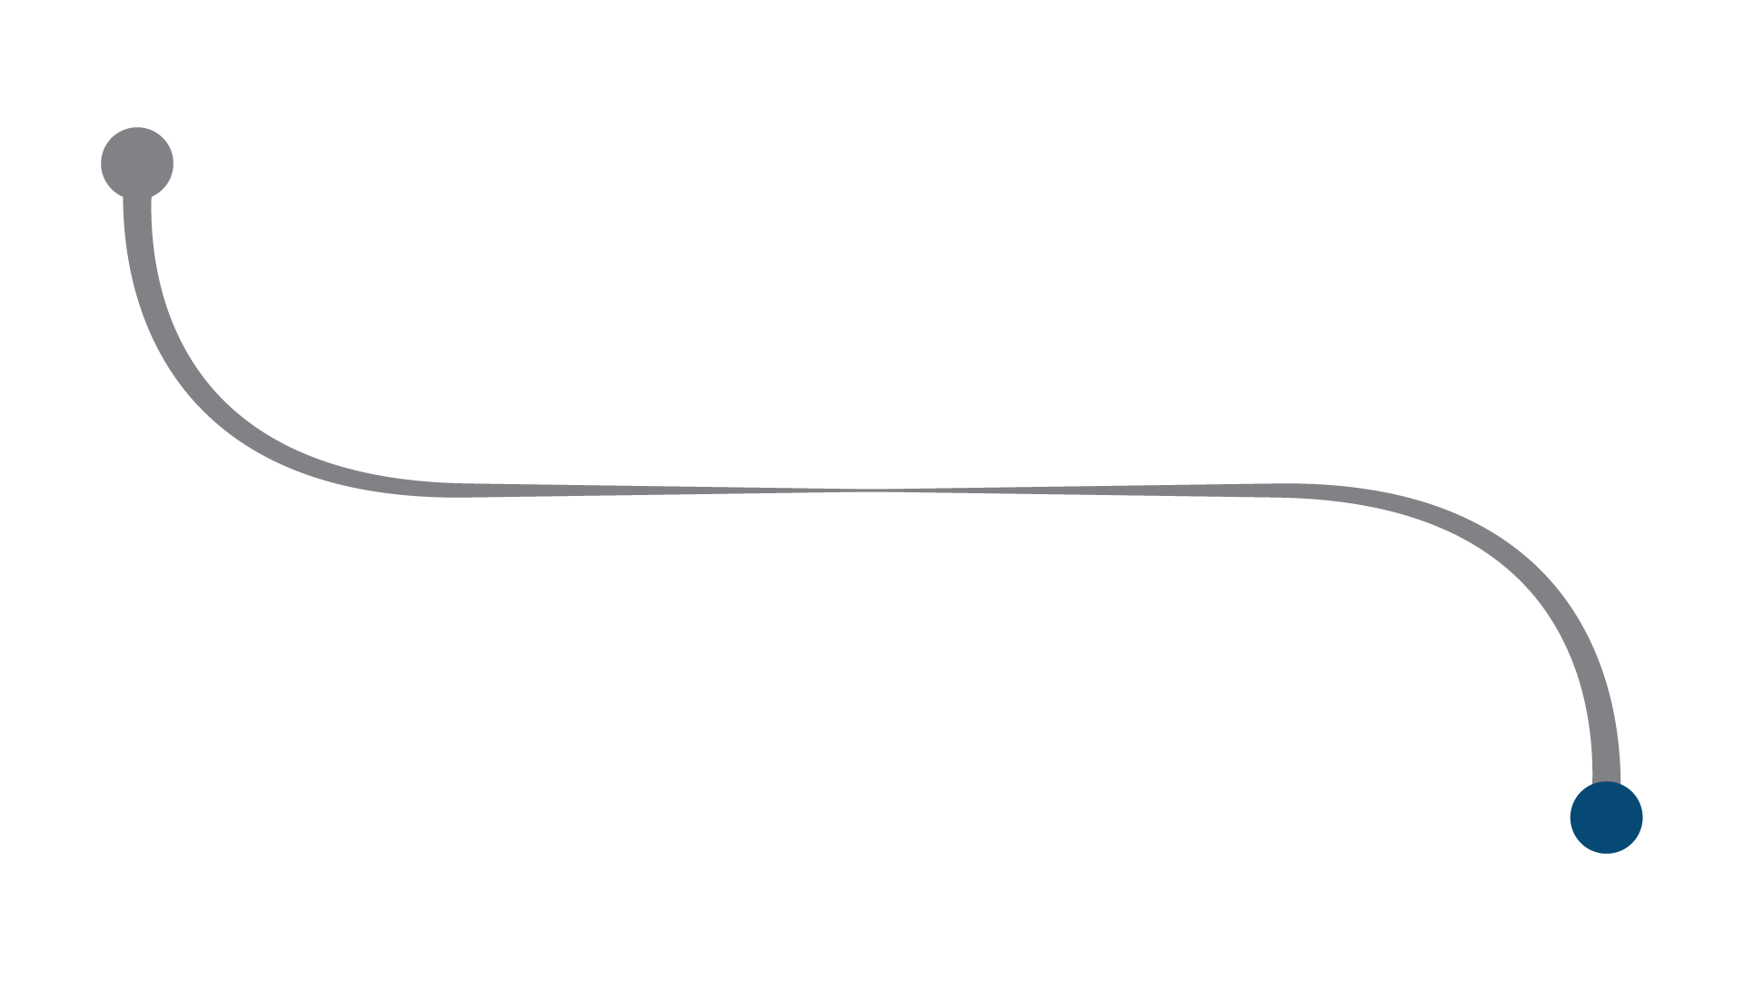

Vision
We identify the long-term vision for the product including strategy, boundaries and goals. The team knows why they are working, what they are working on and what constraints they must work within.
Capabilities are the work item
Recurs annually
Product Owner is primary participant
Spans multiple releases
The flow over the next few pages will breakdown the layers of application portfolio management tool.
The capabilities below were defined while creating the vision.
* subset for illustrative purposes
Application Portfolio Management
Data Management
Report Management
Capability – business objective or outcome of the product or program
To the roadmap >

Slide 4
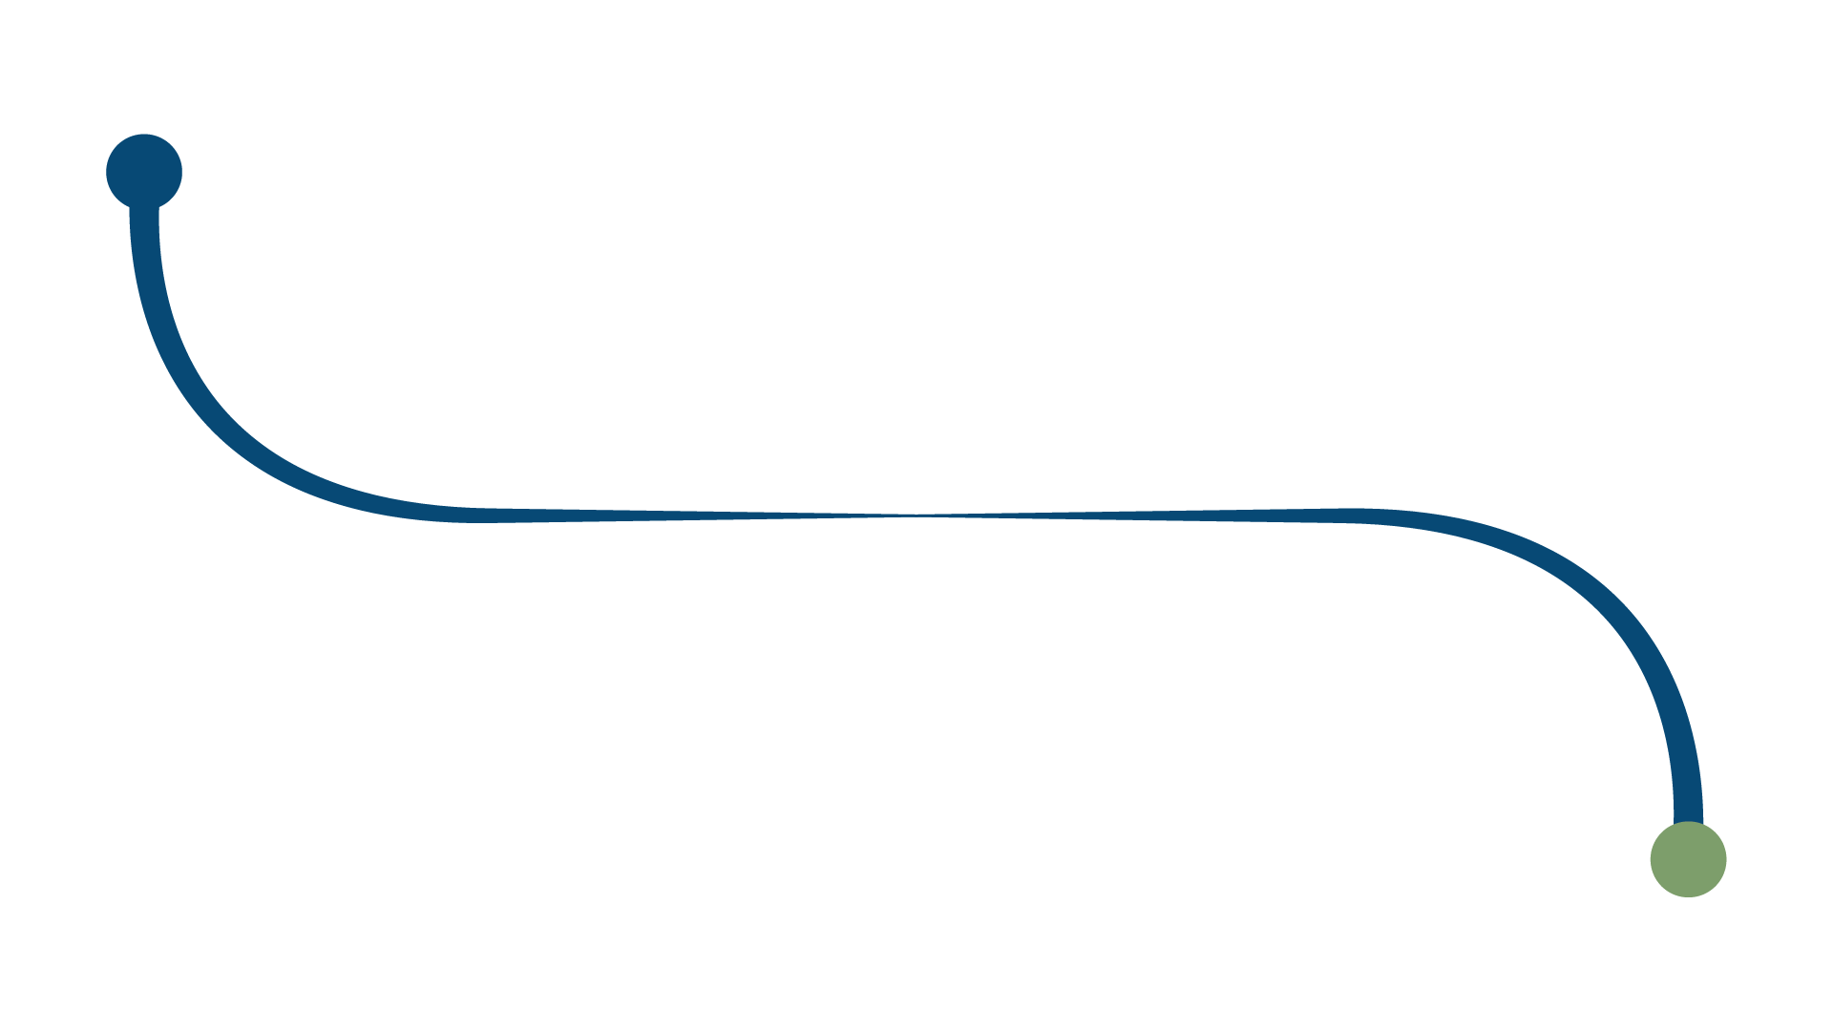
Roadmap
Application Portfolio Management
We’ll establish a rough timeline of high-level features and characteristics the product will deliver to achieve the vision. Includes: Identifying product features, Arranging product features into themes, Estimating t-shirt size (order of magnitude) and priority of features; Determining high level timeframe.
Features are the work item
Recurs semi-annually
Product owner is primary participant
Spans multiple releases
As the Application Portfolio Management capability is elaborated, features below were defined. They have an estimated size as indicated.
Manage Asset Data - L
Manage Product Data- L
Manage Cost Data - M
Feature – what the product does, a grouping of functionality
To the release >

Slide 5
Defining a Feature
High-level business systems / modules / processes that implement the objectives from the Vision statement
Implemented by breaking down into functions
Needs “Success Criteria”
Feature: Template
For | <customers, users>
who | <do something>
the | <solution>
is a | <something – the ‘how’>
that | <provides this value>
Unlike | <competitor, current solution or non-existing solution>
Our solution | <does something better – the ‘why’>

